Slide 1


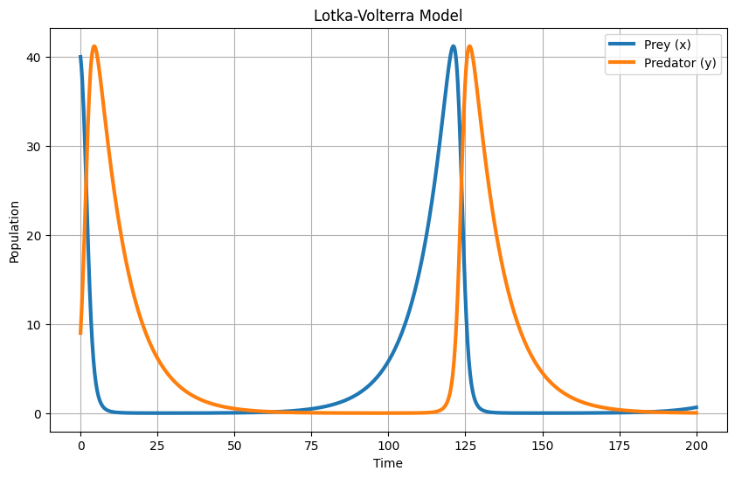



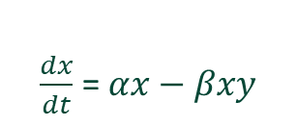
K. J. Somaiya College of Engineering, Mumbai – 400 077
(A Constituent College of Somaiya Vidyavihar University) Dept. of Science and Humanities
F.Y. B. Tech. Semester – I (2023-24)
Applied Mathematics-I
IA-2
Predator-Prey (Lotka-Volterra) Model
Name : Shreyans Tatiya
Roll No : 16010123325
Div. : C5 Batch: C5_3
Definition
Equations
The Predator-Prey model, also known as the Lotka-Volterra model, is a pair of first-order, non-linear, differential equations frequently used to describe the dynamics of biological systems where two species interact, one as a predator and the other as prey. The model was independently developed by Alfred Lotka and Vito Volterra in the early 20th century.
Prey
Predator
$\frac{dx}{dt}$ = $αx−βxy$
$$\frac{dy}{dt}=−γy+δxy$$
Parameters and Their Significance
Prey
Predator
$αx$: Natural growth of prey.
$βxy$: Interaction between prey and predators (β is the interaction rate).
$−γy$: Natural death rate of predators.
$δxy$: Interaction between predators and prey (δ is the interaction rate).

Slide 2

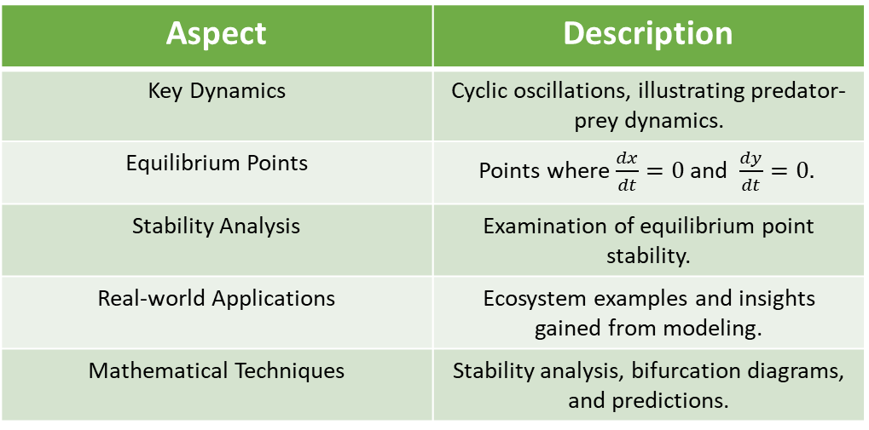
Lotka-Volterra Dynamics
Limitations of Predator-Prey model
Aspect | Description
Model Limitations | Assumptions and constraints affecting accuracy.
Constant Parameters | Assumes unchanging growth rates and interaction coefficients
Linear Interactions | Assumes straightforward relationships, overlooking potential non-linear behaviors in real ecosystems.
Homogeneous Environment | Simplifies conditions as uniform, neglecting spatial heterogeneity's impact on population dynamics.
Predator Satiation | Assumes unlimited prey consumption, neglecting scenarios where predators experience satiation or prey defenses.
No Time Lags | Assumes instant responses to population changes, overlooking time delays present in real-world ecological processes.
Aspect | Description
Key Dynamics | Cyclic oscillations, illustrating predator-prey dynamics.
Equilibrium Points | Points where $\frac{dx}{dt}=0$and $\frac{dy}{dt}=0.$
Stability Analysis | Examination of equilibrium point stability.
Real-world Applications | Ecosystem examples and insights gained from modeling.
Mathematical Techniques | Stability analysis, bifurcation diagrams, and predictions.
Conclusion
The Lotka-Volterra model, though simplified, acts as a valuable lens for exploring predator and prey dynamics in nature.
It captures the essence of cyclic oscillations and interdependence in ecological systems.
Insights gained from the model contribute to understanding the delicate balance governing real-life ecosystems.
Despite its limitations, the Lotka-Volterra model is a foundational tool for predicting and understanding population dynamics.
The model's applications extend beyond theoretical realms, contributing to our comprehension of life in the natural world's ever-changing tapestry.
With the dance of predator and prey, nature orchestrates a harmonious rhythm, showcasing the intricate balance that sustains life in our ecosystems
References
https://mathworld.wolfram.com/Predator-PreyEquations.html-
https://tinyurl.com/yc7tnnfy
https://editors.eol.org/eoearth/wiki/Predator-prey_relationships

